Slide 1


Controlling RealWorldTM elements with Node.js and Arduino
@javierabadia

Slide 2


Controlling RealWorldTM elements with Node.js and Arduino
@javierabadia

Slide 3


Slide 4
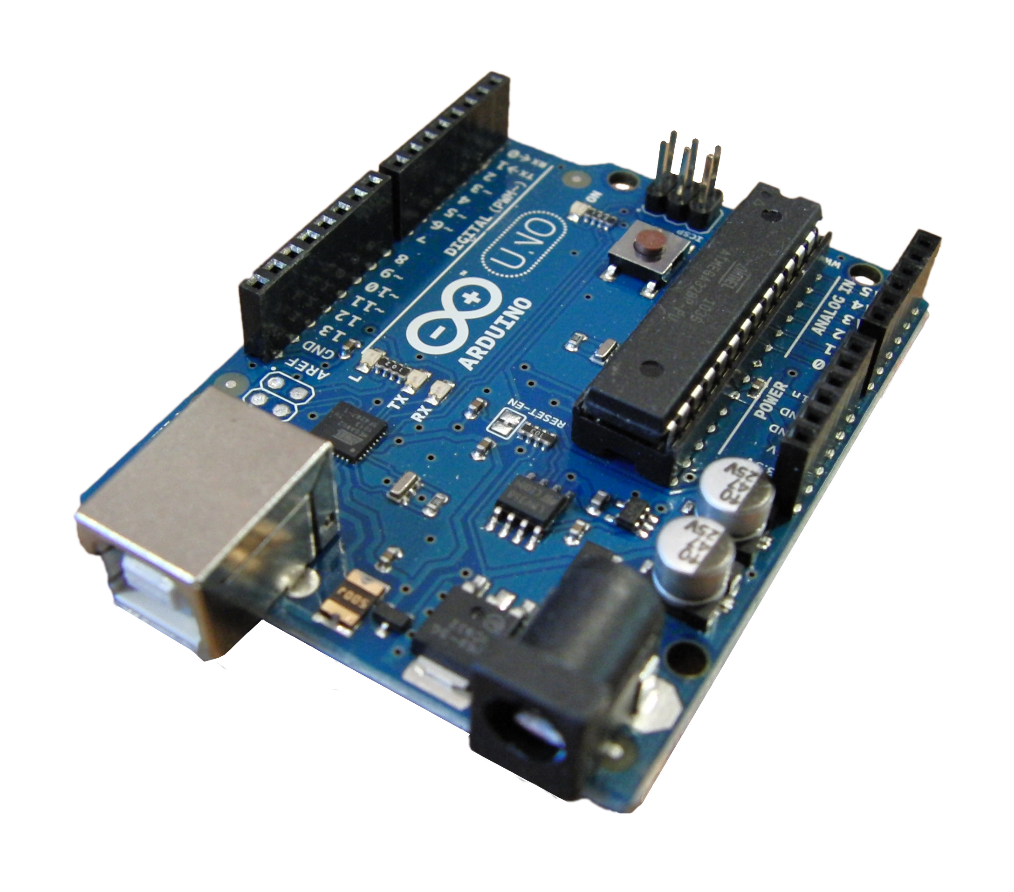
arduino.cc
what is arduino?
Notes:
what is arduino?
it is an open hardware platform that is
inexpensive
cross-platform
simple and easy to program
open and extensible, software and hardware
http://arduino.cc/en/pmwiki.php?n=Guide/Introduction
David Cuartielles, Zaragoza

Slide 5
ATmega microcontroller
digital pins
analog pins
reset button
USB
external
power
Notes:
microcontroller
executes code
analog and digital pins for I/O
external power
USB
- Power
- Code download
- Data I/O
reset button

Slide 6
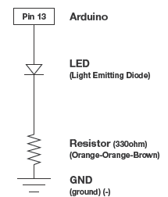
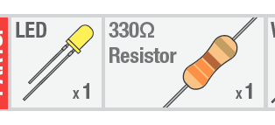
how it works?
Notes:
don’t know a thing about electronics
lots of information in the web

Slide 7
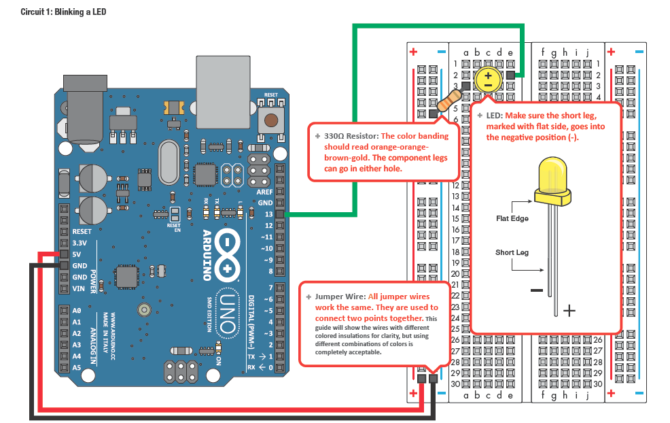
ANIMACION!
wire everything
Notes:
breadboards very convenient, don’t need to solder anything
conected columns and rows

Slide 8
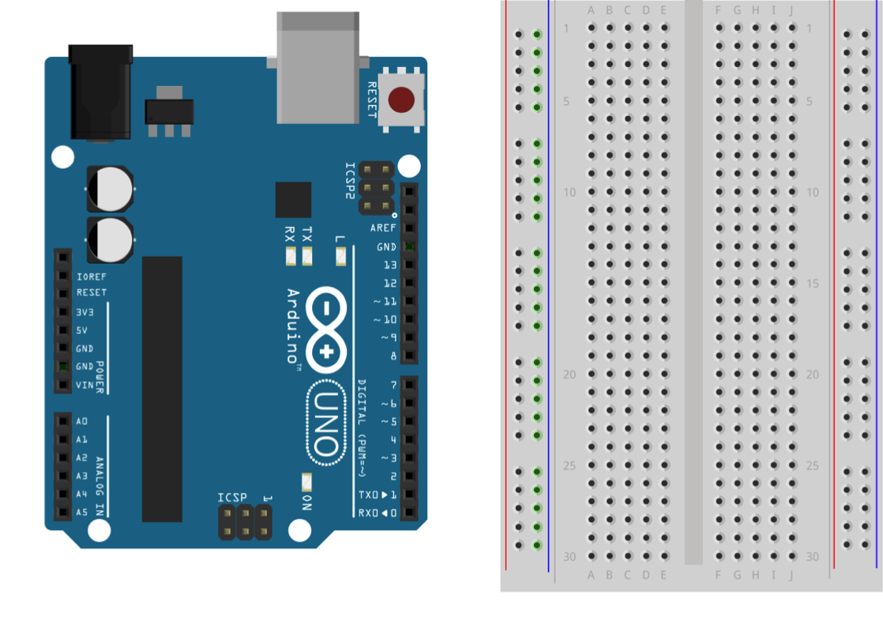
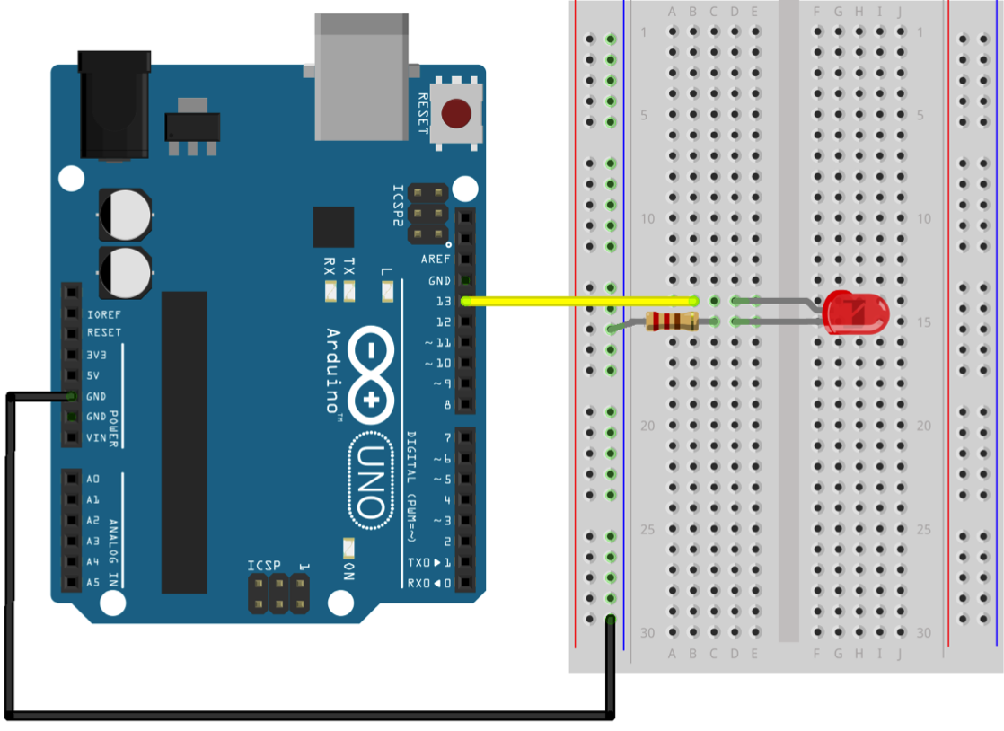
wire everything

Slide 9
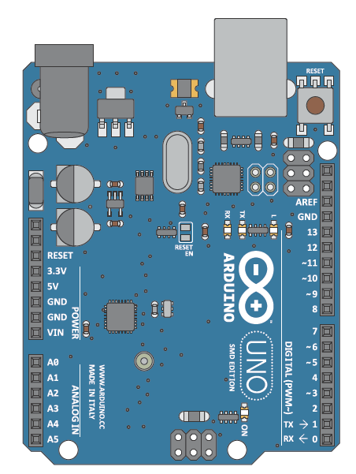
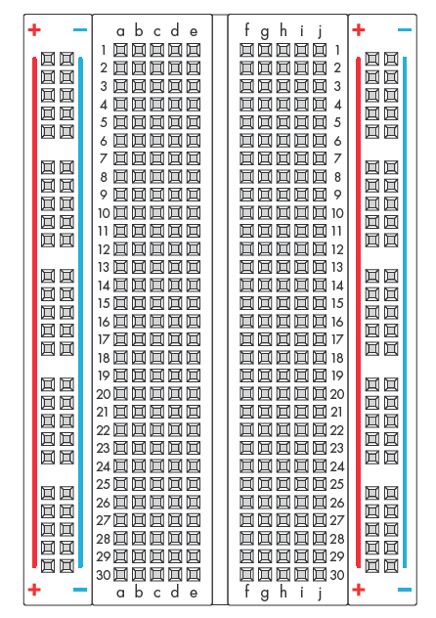

Slide 10
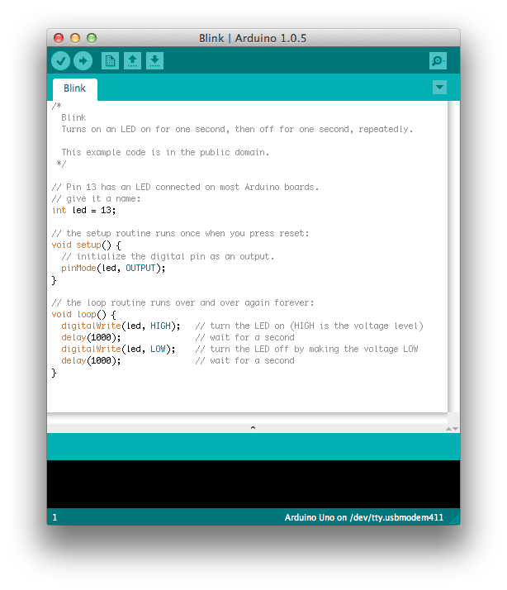
write the code
Notes:
arduino language
based on wiring/processing
http://arduino.cc/en/Reference/HomePage

Slide 11
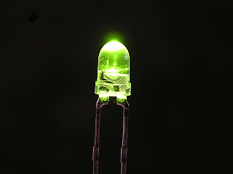
and have [blinking] fun
Notes:
setup
loop
compile in the IDE and transfer to the microcontroller via USB

Slide 12
shields
extend Arduino capabilities
wifi
RF
GPS
LCD
ethernet
…

Slide 13

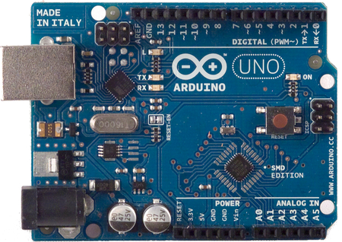
USB
Power
Code download
Data I/O
LOGIC
“you must be the brains here”

Slide 14

Wasn’t this supposed to be about node.js?

Slide 15
npm install johnny-five
ok, ok

Slide 16

npm install johnny-five
ok, ok

Slide 17
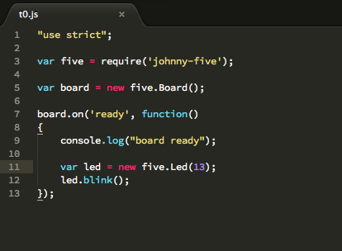
mmm, that sounds familiar
Notes:
demo 0_led.js

Slide 18
USB
Power
Code download
Data I/O
Standard Firmata
LOGIC
“let me drive, honey”

Slide 19
events
objects
higher level
how it works

Slide 20
adding node
https://github.com/ecto/duino
o
http://node-ardx.org/
https://www.npmjs.org/package/johnny-five
https://github.com/firmata/arduino
http://www.voodootikigod.com/nodebots-the-rise-of-js-robotics/

Slide 21
node-ardx.org
change in paradigm
silly hw, intelligent node

Slide 22

SO WHAT

Slide 23
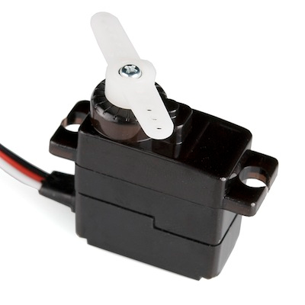
servo fun
Notes:
more powerful logic
use other node packages
connect to internet
send
receive
demo 1_servo.js
demo 2_servo.js

Slide 24

MMM…NOT BAD…

Slide 25
ok, but what’s new
more powerful logic
use other node packages
connect to internet
send
receive

Slide 26
REST
GET
USB
POST
a REST API to your hw

Slide 27

THIS IS COOL
Notes:
demo 3_rest_server.js
clientside
7_leds
6_flex
8_photo
3_distance,4_servo
5_radar

Slide 28
webkit
https://github.com/rwaldron/johnny-five/wiki/Getting-started-with-Johnny-Five-and-Node-Webkit

Slide 29
wifi shields

Slide 30
IDEAS
votaciones con móviles?
QR con la URL para que puedan controlarlo desde el móvil
acertijos para matar o salvar a un muñequito de lego
enganchar el relé con el lego?
acelerómetro + motores + lego?
twilio?

Slide 31
arduino vs raspberry pi
http://hackaday.soup.io/tag/led%20hacks?since=324715366

Slide 32
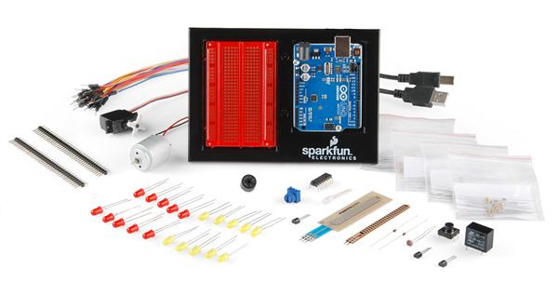
http://github.com/jabadia/wenodetalk
http://node-ardx.org/
https://github.com/rwaldron/johnny-five
SparkFun Inventor’s Kit
ok, let me try!

Slide 33

THANKS!

